Slide 1
ATAI
Advanced Techniqueof Artificial Intelligence
ATAI
ChongqingUniversity _{AdvancedTechniqueof}
of Technology Artificial Intelligence
Chongqing University of
Technology
Chongqing University ^{ATAI}
_{of Technology} Advanced Techniqueof
Artificial Intelligence
Chongqing University of Technology
Chongqing University of Technology
Toward Robust Incomplete Multimodal Sentiment
Analysis via Hierarchical Representation Learning
Code:none
2024.12.15 •ChongQing
—— NeurIPS 2024
Reported by YaoChen Li
1

Slide 2
ATAI
AdvancedTechniqueof
Artificial Intelligence
ATAI
ChongqingUniversity _{AdvancedTechniqueof}
of Technology Artificial Intelligence
ChongqingUniversity of Technology
Motivation
(1)Implementing complex feature interactions for incomplete modalities leads to a large amount of information redundancy and cumulative errors, resulting in ineffective extraction of sentiment semantics.
(2)Lacking consideration of semantic and distributional alignment of representations, causing imprecise feature reconstruction and nonrobust joint representations.

Slide 3
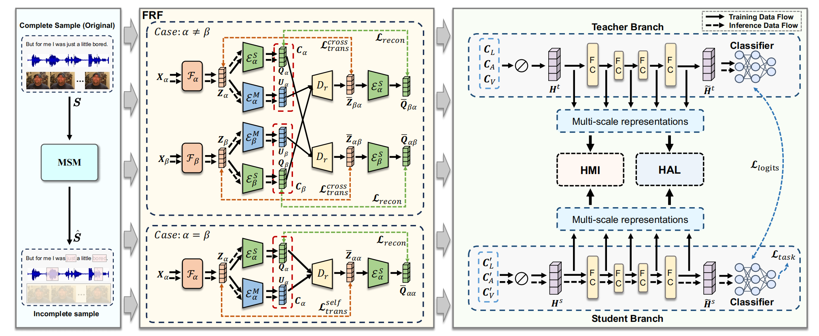
ChongqingUniversity of Technology
ATAI
AdvancedTechniqueof
Artificial Intelligence
ATAI
ChongqingUniversity _{AdvancedTechniqueof}
of Technology Artificial Intelligence
Overview

Slide 4
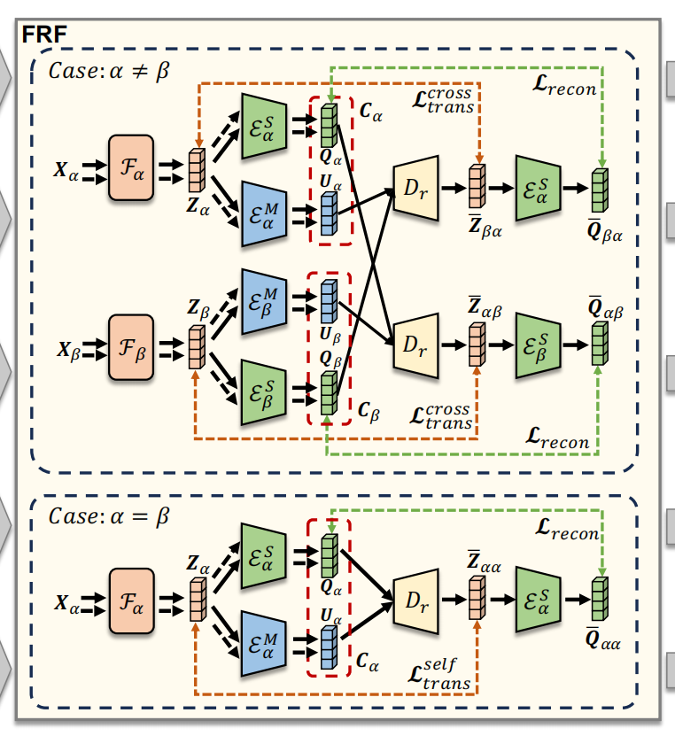
ChongqingUniversity of Technology
ATAI
AdvancedTechniqueof
Artificial Intelligence
ATAI
ChongqingUniversity _{AdvancedTechniqueof}
of Technology Artificial Intelligence
Method
(1)
(2)
(3)
(4)
(5)
(6)
(7)
(8)
(9)
(10)
(11)

Slide 5
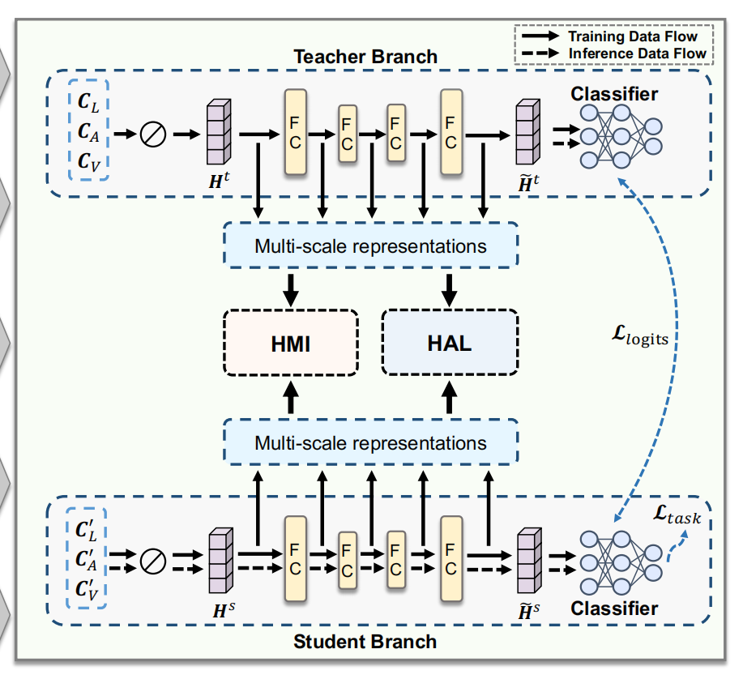
ChongqingUniversity of Technology
ATAI
AdvancedTechniqueof
Artificial Intelligence
ATAI
ChongqingUniversity _{AdvancedTechniqueof}
of Technology Artificial Intelligence
Method
(12)
(13)
(14)
(15)
(16)
(17)
(18)

Slide 6
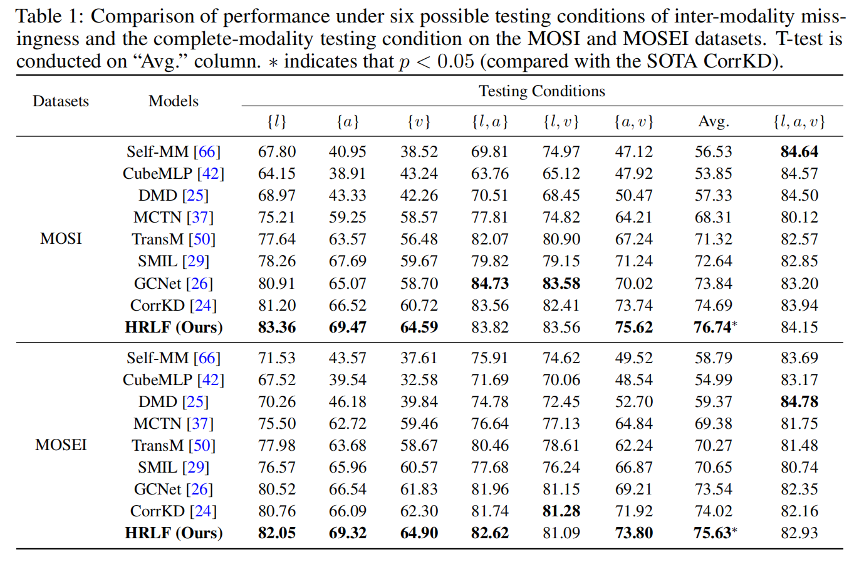
ATAI
AdvancedTechniqueof
Artificial Intelligence
ATAI
ChongqingUniversity _{AdvancedTechniqueof}
of Technology Artificial Intelligence
ChongqingUniversity of Technology
Experiments

Slide 7
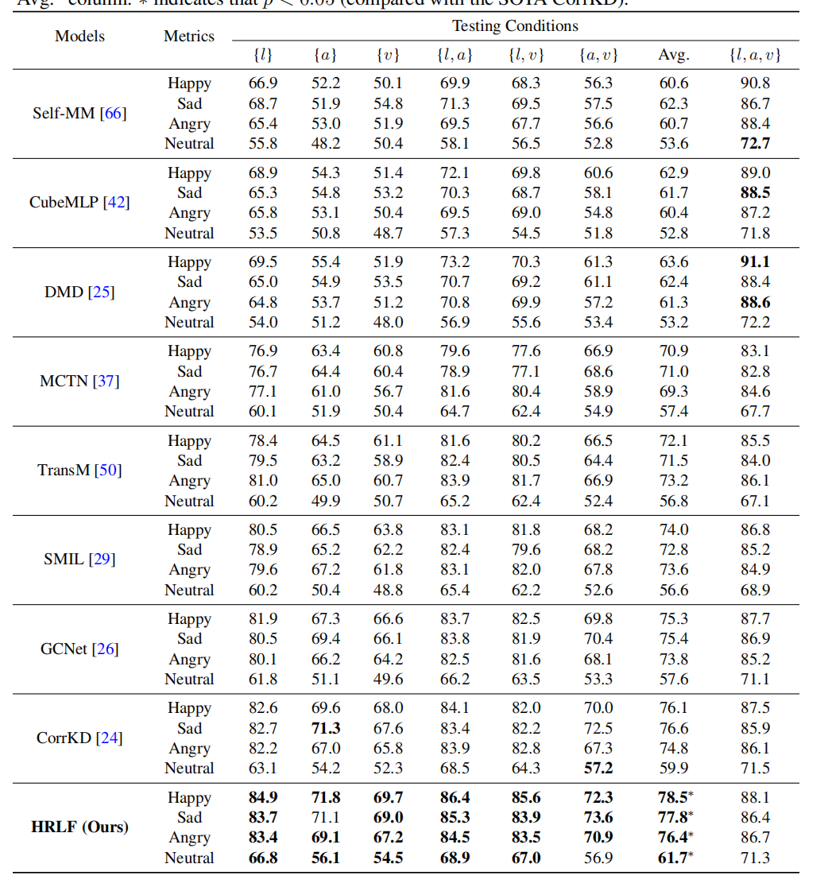
ATAI
AdvancedTechniqueof
Artificial Intelligence
ATAI
ChongqingUniversity _{AdvancedTechniqueof}
of Technology Artificial Intelligence
ChongqingUniversity of Technology
Experiments

Slide 8
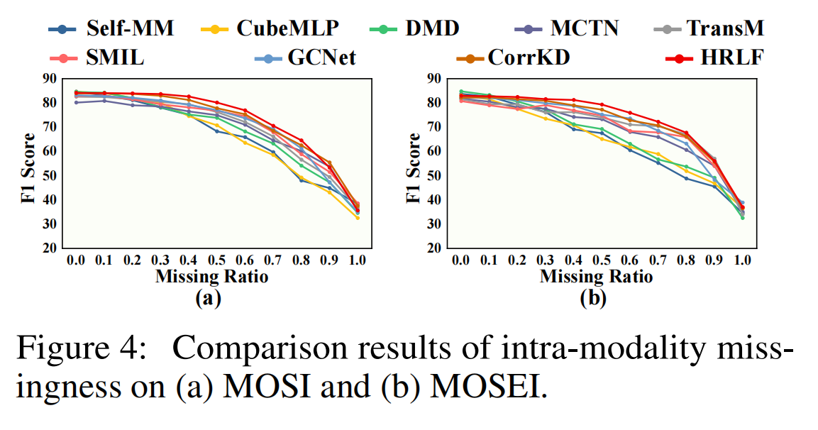
ChongqingUniversity of Technology
ATAI
AdvancedTechniqueof
Artificial Intelligence
ATAI
ChongqingUniversity _{AdvancedTechniqueof}
of Technology Artificial Intelligence
Experiments

Slide 9
ChongqingUniversity of Technology
ATAI
AdvancedTechniqueof
Artificial Intelligence
ATAI
ChongqingUniversity _{AdvancedTechniqueof}
of Technology Artificial Intelligence
Experiments

Slide 10
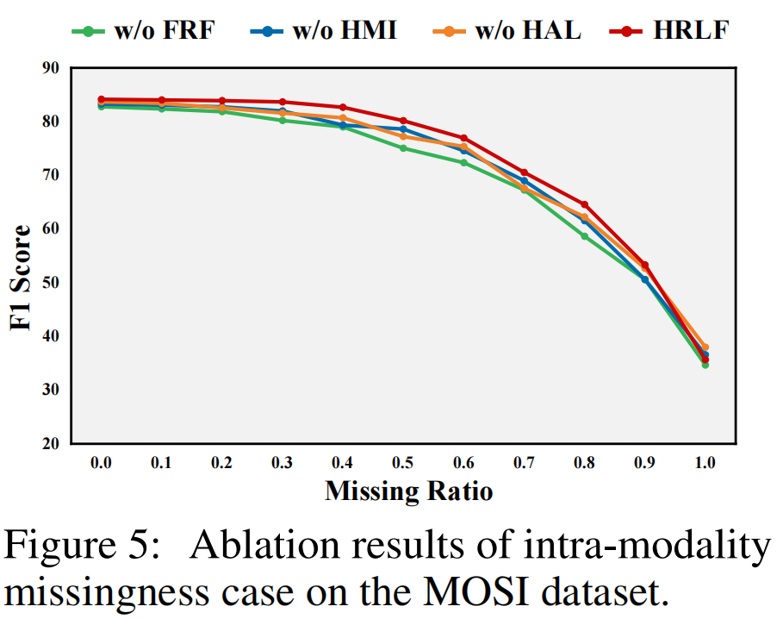
ChongqingUniversity of Technology
ATAI
AdvancedTechniqueof
Artificial Intelligence
ATAI
ChongqingUniversity _{AdvancedTechniqueof}
of Technology Artificial Intelligence
Experiments

Slide 11
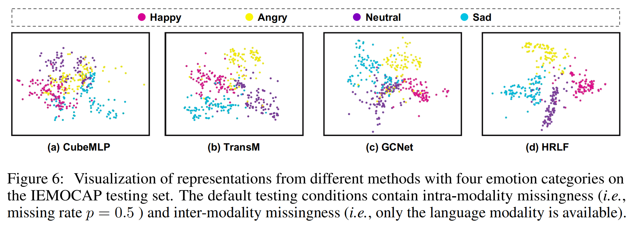
ChongqingUniversity of Technology
ATAI
AdvancedTechniqueof
Artificial Intelligence
ATAI
ChongqingUniversity _{AdvancedTechniqueof}
of Technology Artificial Intelligence
Experiments

Slide 12
ChongqingUniversity of Technology
ATAI
AdvancedTechniqueof
Artificial Intelligence
ATAI
ChongqingUniversity _{AdvancedTechniqueof}
of Technology Artificial Intelligence
Thanks!

